Slide 1
How to write good code? (CodeRefinery) introduction

Slide 2
Software Engineering is Programming integrated over time
Titus Winters, Google C++ devlead

Slide 3
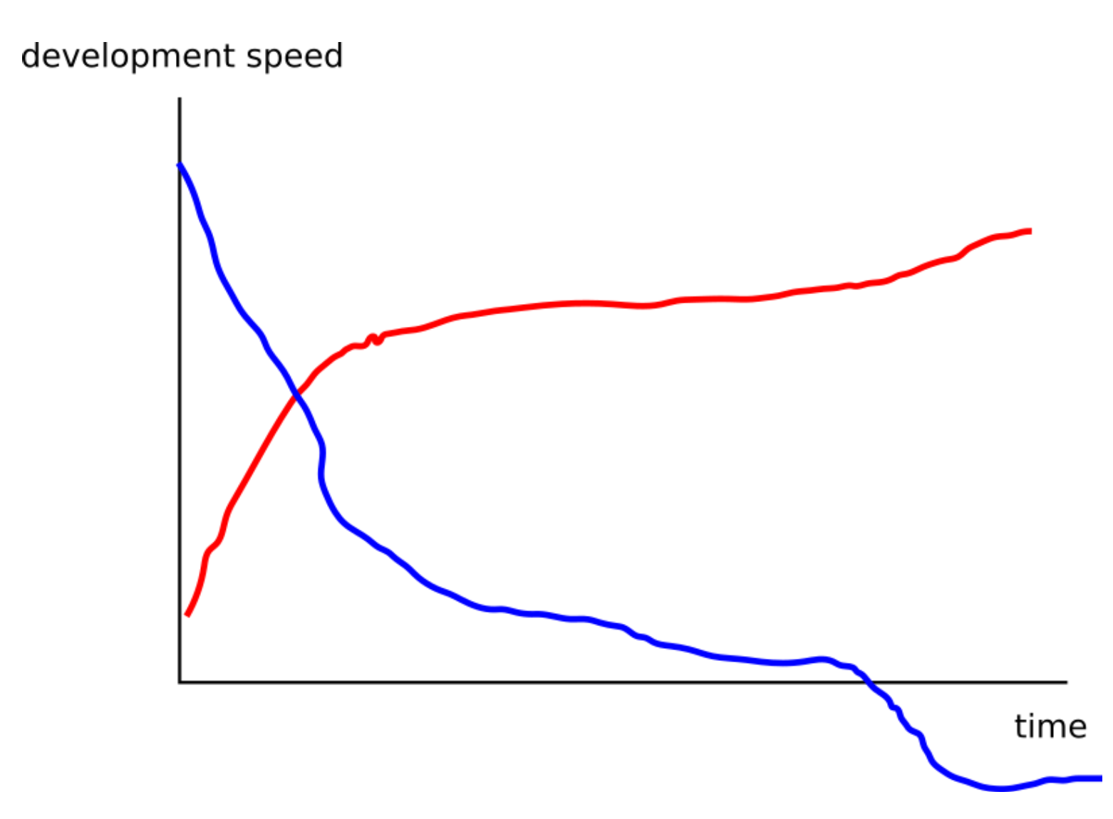
Software engineering tools can speed up development on the long run
To get on the red curve:
Version Control
Github
Code Review
Testing
Modular coding
Documentation

Slide 4
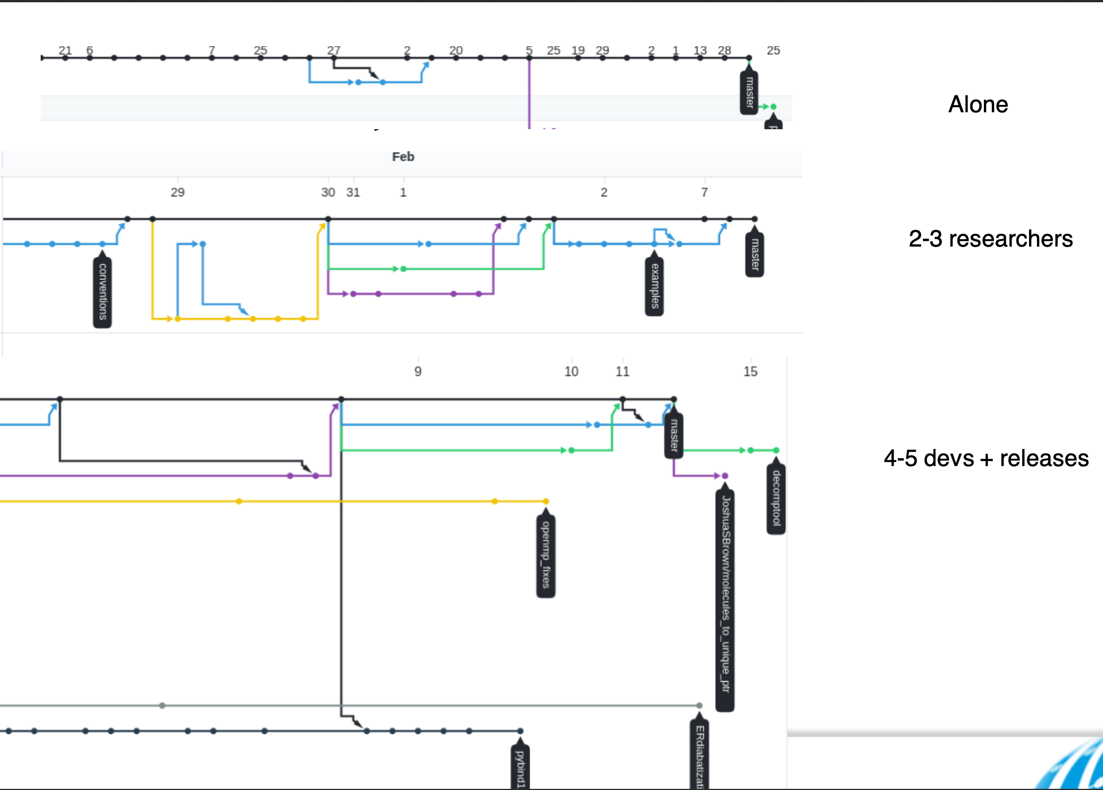
All projects are different

Slide 5
How to decide what to use?
How long should this code last?
Longer than a week -> Use version control + Github
Longer than 3 months -> write tests
Longer than half a year -> Write documenation and automate tests
How may people use it?
1 -> just push to main branch
2+ -> use branches and merge to main
2+ (+ students) -> Code Review
2+ (+outside users) -> Release branch + everything else

